Slide 1
Lab 3: Introduction to hardware description language (cont)

Slide 2
Structural modeling
- Previous section discuss behavioral modeling
- Behavioral modeling: describing a module in terms of relationships between inputs and outputs
- Complex circuit -> Using structural modeling
- Strutural modeling: describing a module in terms of how it is combined from simpler module.
Ex: Design a 4: 1 multiplexer using 2:1 multiplexer
4:1 multiplexer:
4 data input: in1, in2, in3, in4
2 control input: ctr1, ctr2
=> Write a 4: 1 multiplexer using 3 2:1 multiplexer.
module mux4(input logic in1,in2,in3,in4, input logic ctr1, ctr2, output logic out); assign out = ctr1 ? (ctr2 ? in4 : in3) : (ctr2 ? in2 : in1); endmodule | module mux2(input logic in1, in2, ctr output logic out); assign out = ctr ? in1 : in2; endmodule

Slide 3
Exercise 1:
Design a 4:1 multiplexer using 2:1 multiplexer in SystemVerilog, simulate on ModelSim and test operations of design in DE-10 board.

Slide 4
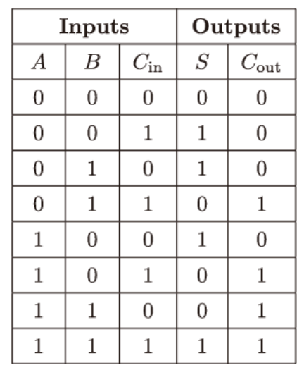



Internal variables
Design complex circuit with complex function
Break a function into intermediate steps
Using internal variables
Internal variables are neither inputs nor outputs but are used only internal to module; similar to local variables in programming languages
Example: Full-adder
3 inputs: A, B, Cin
2 outputs: Sum, Carry
Boolean equations:
Define intermediate signals P and G:
Rewrite full adder as follow:

Slide 5
Internal variables (cont)
Example: Full-adder
3 inputs: A, B, Cin
2 outputs: Sum, Carry
Boolean equations:
Define intermediate signals P and G:
Rewrite full adder as follow:
Using internal variables:
- Declaration
Ex: logic P;
- Assignment
Ex: assign P = A ^ B;

Slide 6
Exercise 2:
Design a full adder using internal variables and continuous assignment statement in SystemVerilog, simulate on ModelSim and test operations of design in STEP MAX-10 board.

